Slide 1

Python Level 2
882.33
Lesson 3: Getting Classy

Slide 2
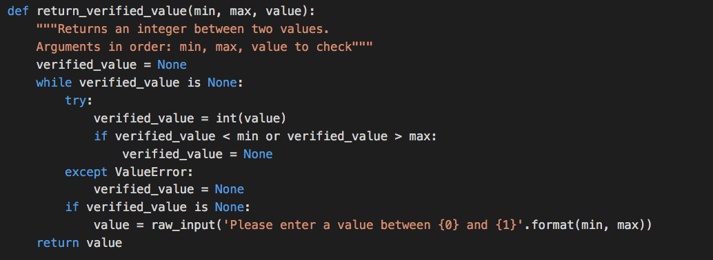

Previously…

Slide 3
What is a Restaurant?
What properties does a Restaurant have?

Slide 4
What is a Restaurant?
What properties does a Restaurant have?
How much we like it
How far away it is
What sort of food it sells
How expensive it is
Anything else?

Slide 5
What is a Restaurant?
What properties does a Restaurant have?
How much we like it
How far away it is
What sort of food it sells
How expensive it is
Anything else?
It might be a takeaway
It might have a dress code

Slide 6
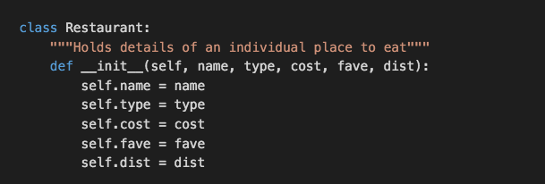
What does this do?

Slide 7


How do we invoke it?
What will this do?

Slide 8
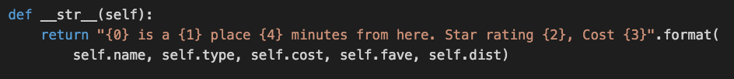

What happened?
When you print, Python tries to render the output as a string
Python doesn’t know how to turn a Restaurant object into a string
Another member method for the Restaurant class:
Does print moro work now?

Slide 9
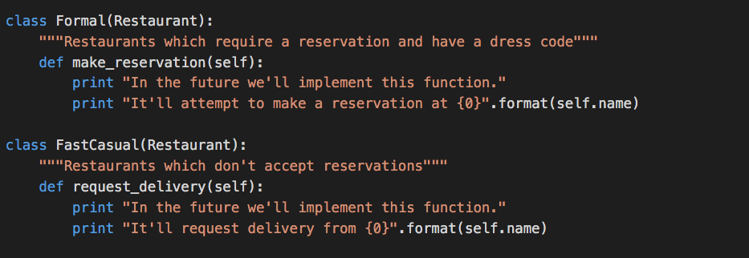
Being more specific

Slide 10
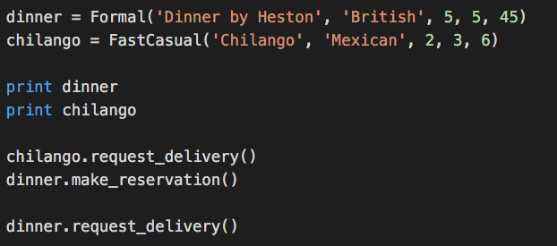
Getting your inheritance

Slide 11
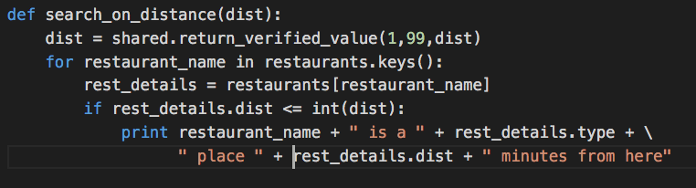
Exercise/Homework…
Update the rest of your program (load, save, search) to use an instance of Restaurant instead of a dictionary
Example:
Questions? Comments? Come see us in S32, on Monday, 11:00 – 12:00

